Slide 1



Java Internationalization
(Part 2)
Reference:
Java-Tutorials/tutorial-2015/index.html

Slide 2
Objectives
How to specify cultural symbols in properties file?
How to create a compound message?

Slide 3
Contents
Formatting Date and Time
Specifying cultural symbols in properties files
Compound Message
Demonstrations

Slide 4
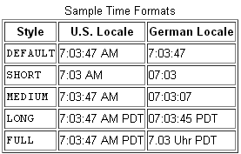
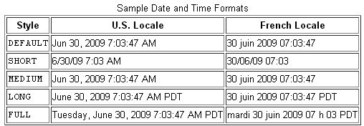
1-Formatting Date and Time
Notes:
Pacific Daylight Time (PDT) is 7 hours behind Coordinated Universal Time (UTC). This time zone is a DST (daylight saving time) time zone and is used in:North America.
This time zone is often called Pacific Daylight Time.

Slide 5
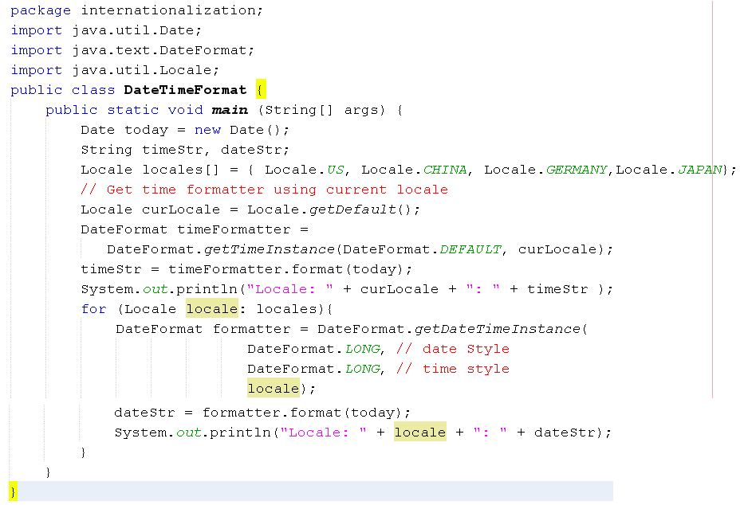

Demo 2: Formatting Date/Time…

Slide 6
Enabled Locales for java.util and java.text Functionality
Language | Country | Locale ID
Chinese (Simplified) | China | zh_CN
Danish | Denmark | da_DK
English | Australia | en_AU
English | Canada | en_CA
English | United States | en_US
French | France | fr_FR
Vietnamese | Vietnam | vi_VN
http://www.oracle.com/technetwork/java/javase/locales-137662.html

Slide 7
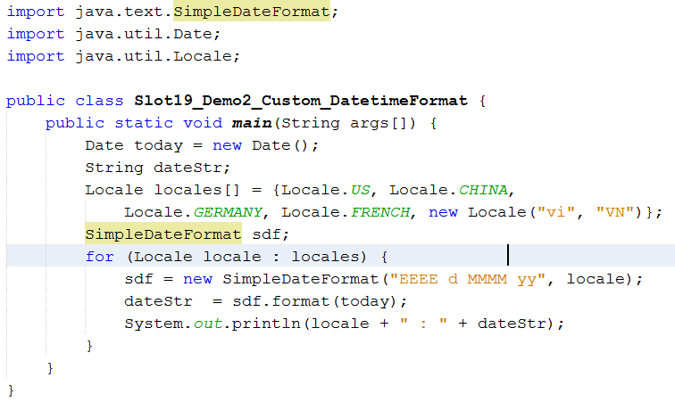
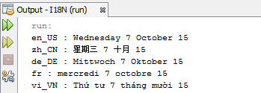
Demo 3: Custom Formatting Date/Time…

Slide 8
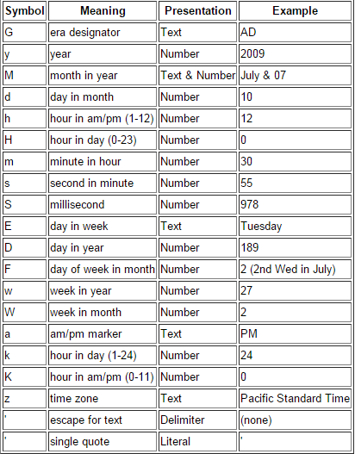
Date/Time Symbol…

Slide 9
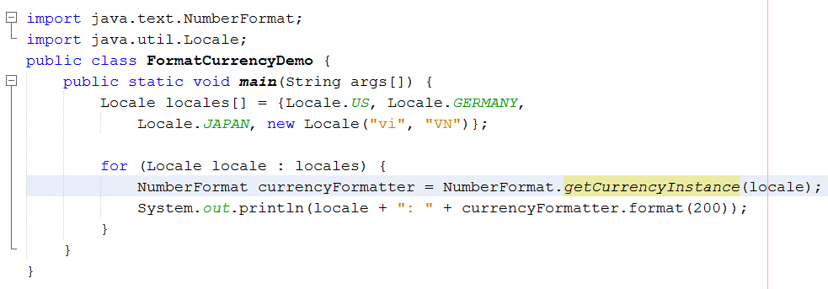
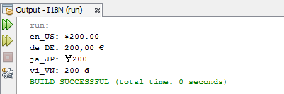
2- Cultural Symbols in Property File
Demo 4: Currency Format
Notes:
https://docs.oracle.com/javase/tutorial/i18n/format/numberFormat.html

Slide 10
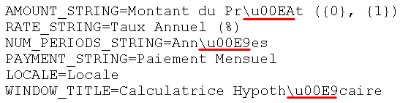
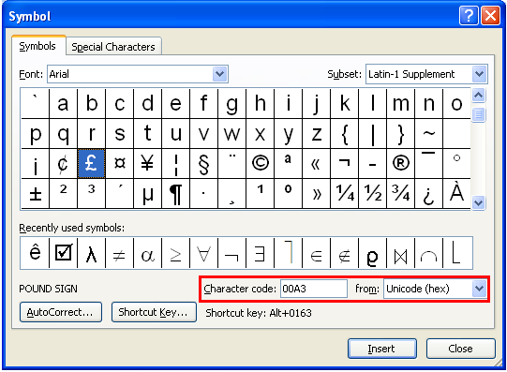
2- Cultural Symbols in Property File
Cultural Symbols: Alphabets, Digits, Currency symbol…
Use hexadecimal Unicode for particular symbols (\uXXXX).
You can use the function “Insert symbol” of the MS Word to find Unicode of a symbol.
tutorial-2015/i18n/format/examples/resources/ Resources_fr.properties
Notes:
https://docs.oracle.com/javase/tutorial/i18n/format/numberFormat.html

Slide 11

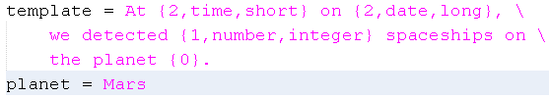
3- Compound Message
Compound message = string template + embedded data Example:
In the message’s template, marks must be used. Example:
The character ‘\’ is used as a concatenation
To mix data to the template, an array of objects are used, number in a mark is the object’s index in this array. Syntax for a mark: { index, type, format}

Slide 12
java.text.MessageFormat
Type | Format | Subformat Created
number | integer | NumberFormat.getIntegerInstance(getLocale())
 | currency | NumberFormat.getCurrencyInstance(getLocale())
 | percent | NumberFormat.getPercentInstance(getLocale())
date | short | DateFormat.getDateInstance(DateFormat.SHORT, getLocale())
 | medium | DateFormat.getDateInstance(DateFormat.DEFAULT, getLocale())
 | long | DateFormat.getDateInstance(DateFormat.LONG, getLocale())
 | full | DateFormat.getDateInstance(DateFormat.FULL, getLocale())
time | short | DateFormat.getTimeInstance(DateFormat.SHORT, getLocale())
 | medium | DateFormat.getTimeInstance(DateFormat.DEFAULT, getLocale())
 | long | DateFormat.getTimeInstance(DateFormat.LONG, getLocale())
 | full | DateFormat.getTimeInstance(DateFormat.FULL, getLocale())

Slide 13
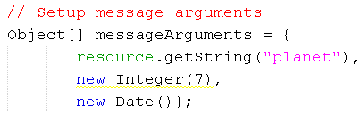
Compound Message…
Index=0
Index=1
Index=2

Slide 14
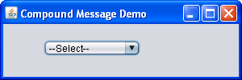
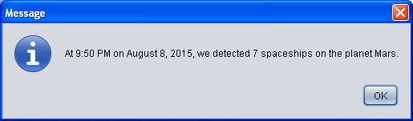
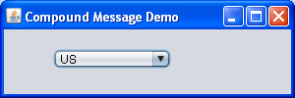

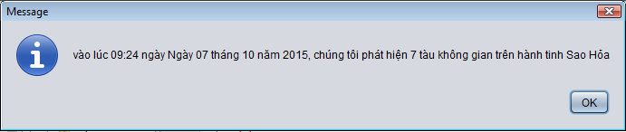
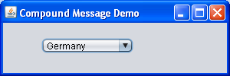
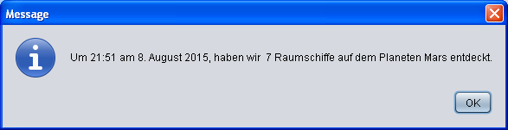
Demo 5 - 1

Slide 15
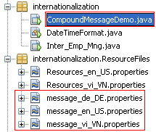

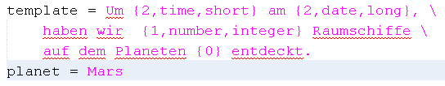

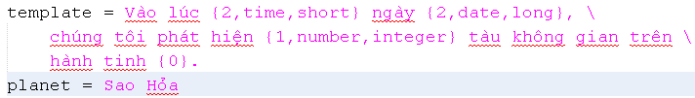
Demo 5 - 2
Model
--Select—
US
VietNam
Germany

Slide 16
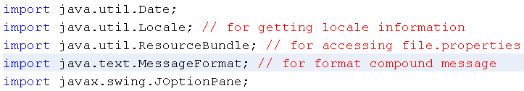
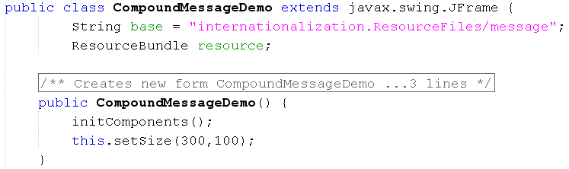
Demo 5 - 3

Slide 17
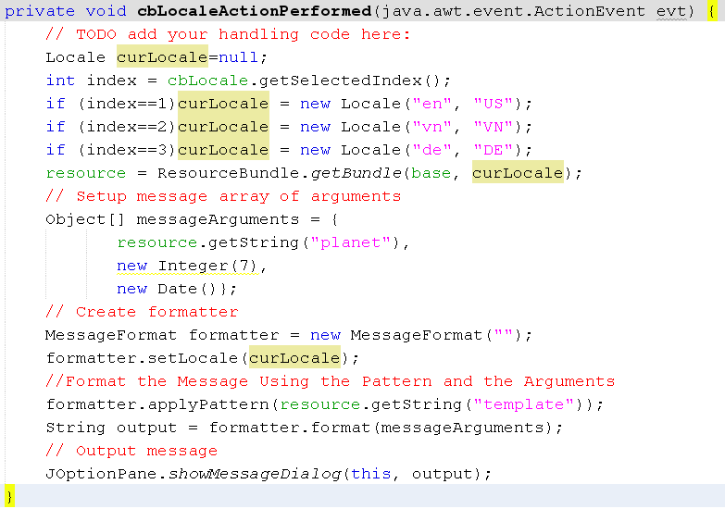
Demo 5 - 4
Notes:
https://docs.oracle.com/javase/8/docs/api/java/text/MessageFormat.html

Slide 18
Summary
Formatting Date and Time
Specifying cultural symbols in properties files
Compound Message

